Slide 1
Syringe Infographic
WRITE YOUR SUBTITLE HERE
Your Title
Your Title
Your Title
Your Title
Your Title
A good business plan starts with a summary
A good business plan starts with a summary
A good business plan starts with a summary
A good business plan starts with a summary
A good business plan starts with a summary

Slide 2
Syringe Infographic
WRITE YOUR SUBTITLE HERE
Your Title
Your Title
Your Title
Your Title
A good business plan starts with a summary
A good business plan starts with a summary
A good business plan starts with a summary
A good business plan starts with a summary

Slide 3
Lab Research Infographic
WRITE YOUR SUBTITLE HERE
75%
95%
A business plan is a written document that describes in detail how a business, usually a new one, is going to achieve its goals. A business plan lays out a written plan
A business plan is a written document that describes in detail how a business, usually a new one, is going to achieve its goals. A business plan lays out a written plan

Slide 4
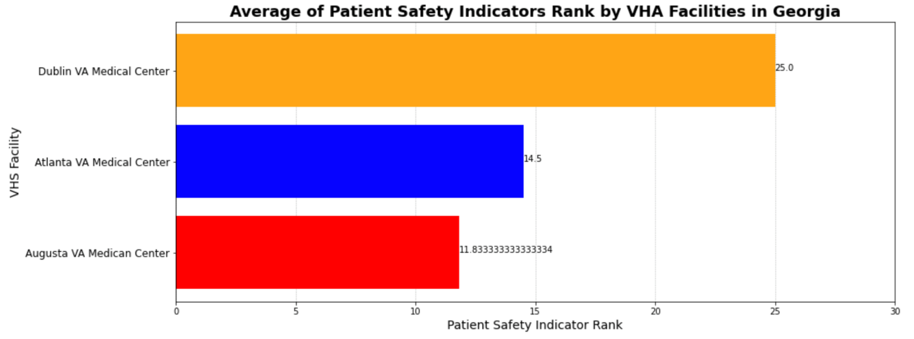
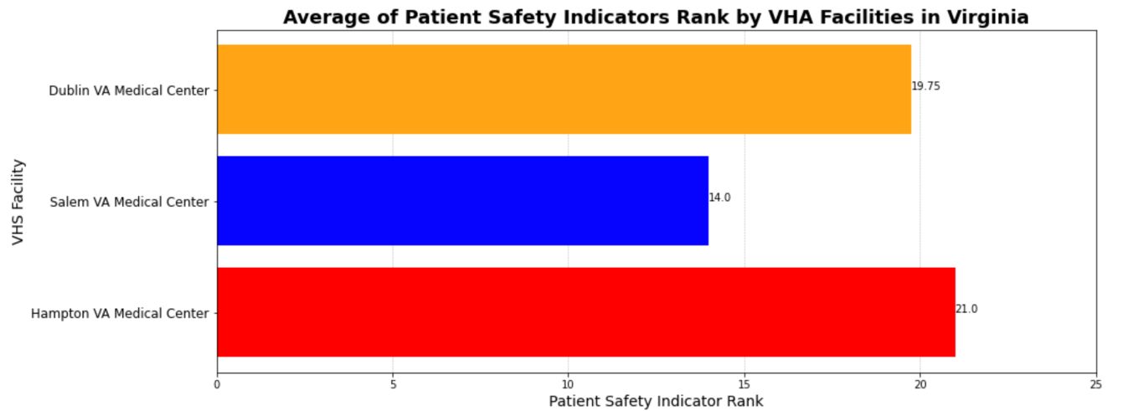
Average of Patient Safety Indicators Rank by Hospitals in Georgia and Virginia
Objective
Compare Patient Safety Indicator Ranks between different measures. Calculate rank for each measure by hospital and the average PSI overall by hospital.
O
Main Pandas and Matploitlab code used
Data-frames, ranks, horizontal bars (barh) and adding labels to each bar applying ax1.
C
Your Title
A good business plan starts with an executive summary of the business goals
AB
Your Title
A
A good business plan starts with an executive summary of the business goals

Slide 5
X-Ray Infographic
WRITE YOUR SUBTITLE HERE
A business plan is a written document that describes in detail how a business, usually a new one, is going to achieve its goals. A business plan is a written document that describes in detail how a business, usually a new one, is going to achieve its goals.
Your Title
Your Title
A good business plan starts with an executive summary of the business goals
A good business plan starts with an executive summary of the business goals
98%
35%

Slide 6
Doctor & Nurse Infographic
WRITE YOUR SUBTITLE HERE
Structure
A good business plan starts with an executive summary of the business goals
Strategies
A good business plan starts with an executive summary of the business goals
Your Title
65%
Your Title
5%

Slide 7
Comparative Analysis of
measures of Veterans Affairs Hospitals
between the states of Georgia and Virginia.
75%
95%
Death Rate between Virginia and Georgia in-state facilities
Patient safety measures derived from routinely collected hospital data is reviewed to compare indicators.
Re Admission-Rate between Virginia and Georgia in-state facilities
This analysis, presents findings from dataset posted on Homeland Infrastructure Foundation-Level Data (HIFLD).
Veterans Health Administration Medical Facilities dataset includes Veteran Affairs hospitals, Veteran Affairs Residential Rehabilitation Treatment Programs (RRTP), Veteran Affairs Nursing Home Care Units (NHCU), and more.

Slide 8
Patient Safety Measures A Routinely Collected Hospital Data
A potential preventability of the complication, and the ability of the indicator to identify medical error.
Safety Measure
Matrix
Data Used
Governance
These indicators serve as flags for potential quality problems (adverse events) rather than provide definitive measures of quality of care.
The PSI module contains 11 hospital-level indicators that reflect the quality of care provided by hospitals.
Dataset for the Patient Safety Indicator (PSI) module for the range of October 2012 to September 2015.
According to the AHRQ, these indicators are selected based on their ability to screen out conditions present on admission from conditions that develop after admission,

Slide 9
Average of Patient Safety Indicators Rank by Hospitals in Georgia and Virginia
Objective
Compare Patient Safety Indicator Ranks between different measures. Calculate rank for each measure by hospital and the average PSI overall by hospital.
Main Pandas and Matploitlab code used
Data-frames, ranks, horizontal bars (barh) and adding labels to each bar applying ax1.

